Slide 1
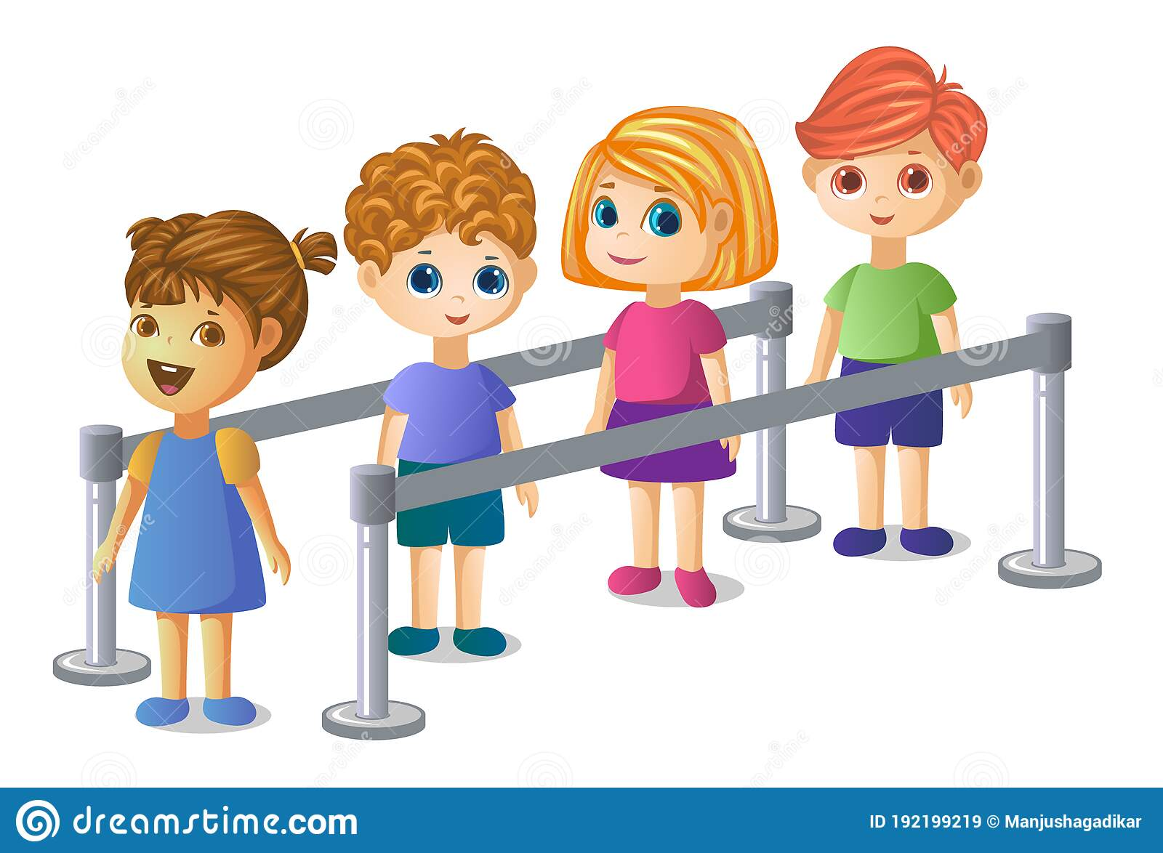
QUEUE

Slide 2
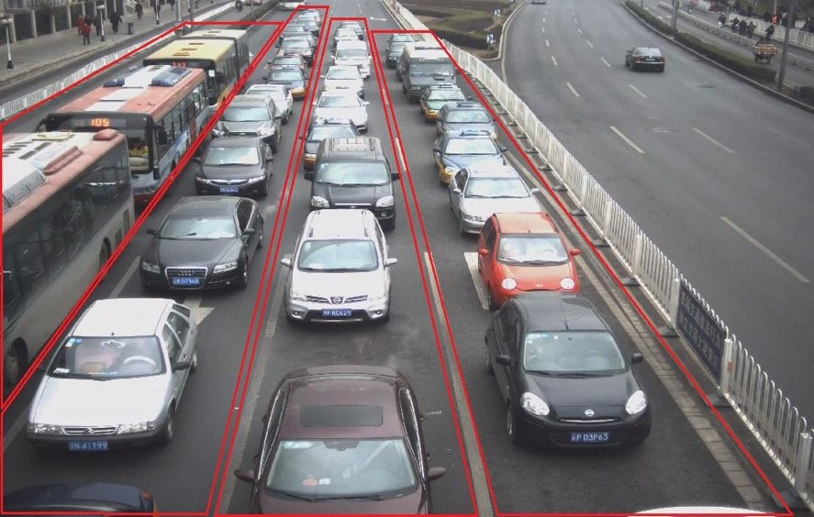
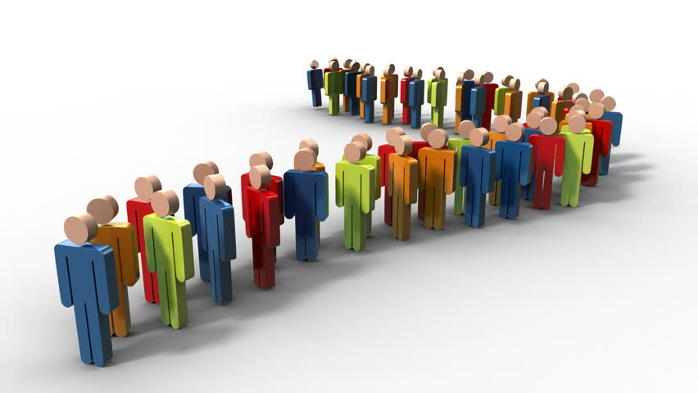
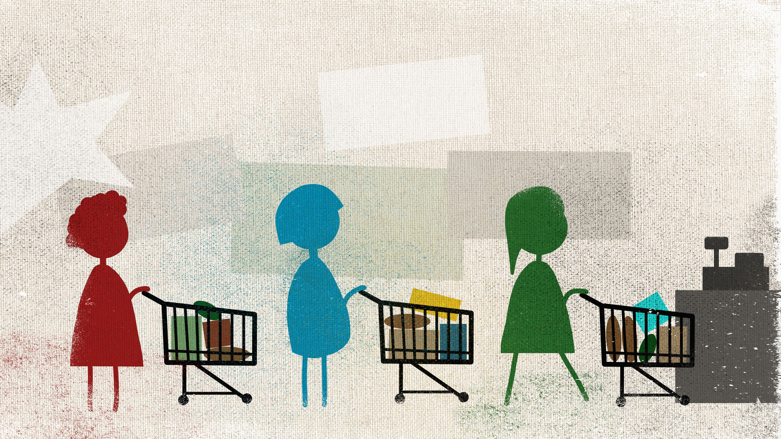
QUEUE
Queue is a line or sequence of people or vehicles awaiting their turn to be attended to or to proceed is called Queue.
Queue is a line of people or things or objects awaiting their turn to be attended is called Queue.

Slide 3
QUEUE
It Is a linear structure of items (like mechanical parts assembling) and waiting for their turn.
Queue is line of items waiting for their turn.
Queue has two ends:
Elements are added at one end (REAR END).
Elements are removed from the other end (FRONT END).
EXAMPLES OF QUEUE: People waiting in Queue to purchase tickets at railway station or cinema hall, where the first person in the queue will be served first.

Slide 4
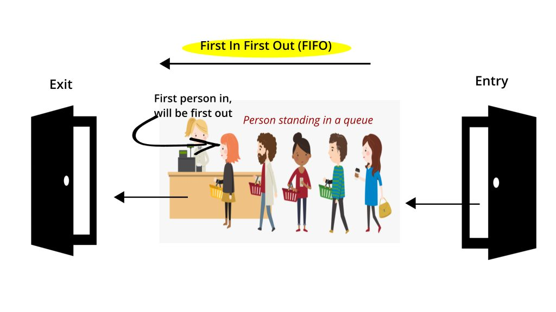
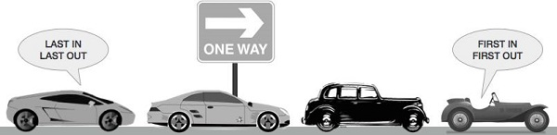
GENERAL WORKING PRINCIPLE OF QUEUE (FIFO)
It works on the principle of FIFO (First In First Out). That is, the element that is added first, it is removed first, and the element that is added to the last, it is removed at the end.

Slide 5
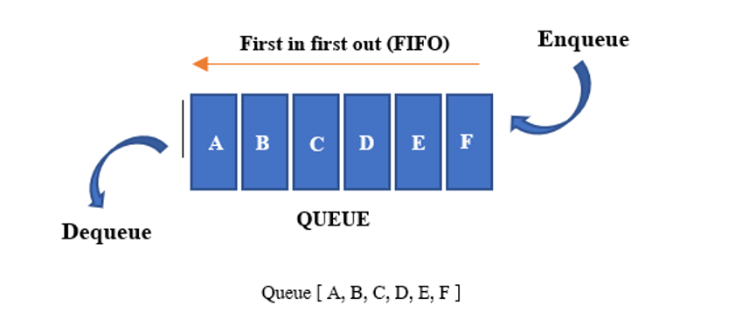
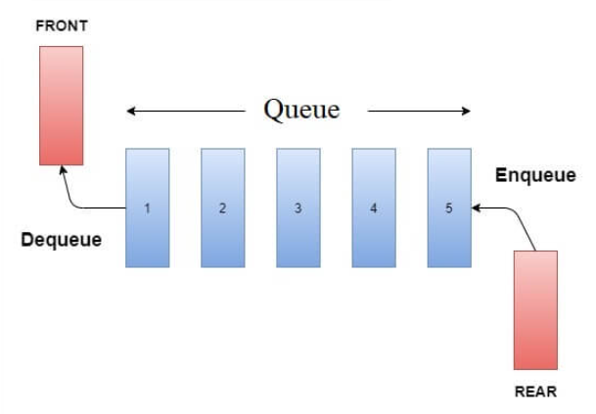
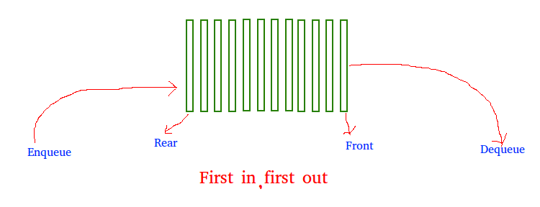
GENERAL WORKING PRINCIPLE OF QUEUE (FIFO)

Slide 6
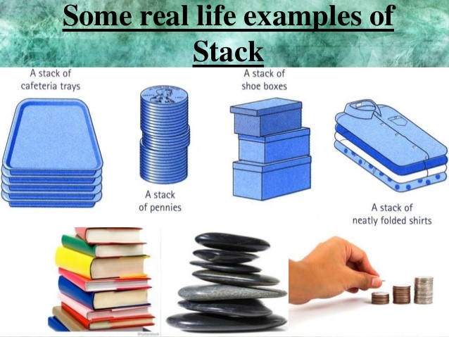
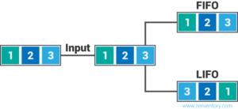
LIFO (STACK)
A collection of items are added and removed from one end, called the top of the Stack.
"LIFO" stands for last-in, first-out, meaning that the most recently produced items are recorded as sold first.
Example: A Stack of Plates

Slide 7
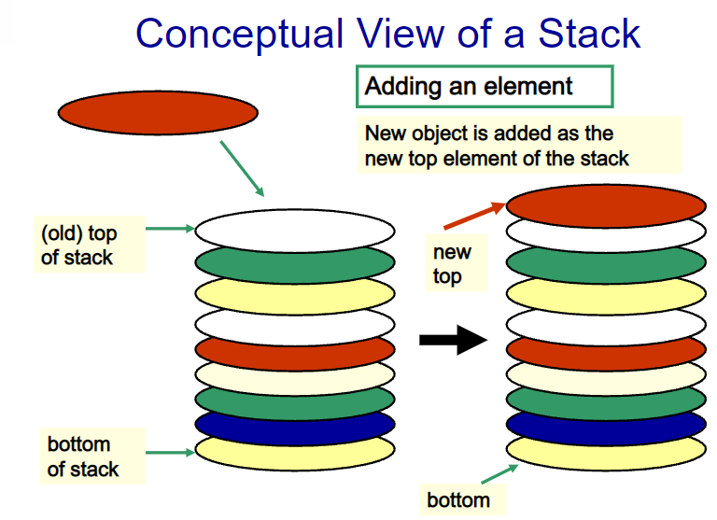
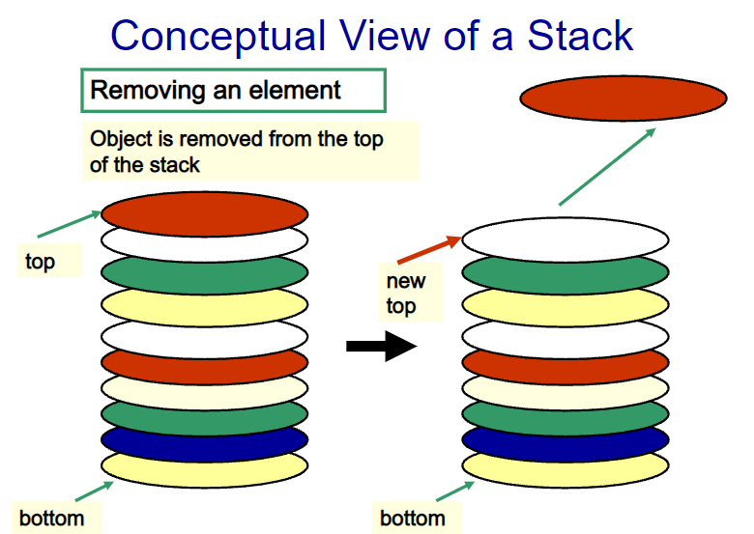
LIFO (STACK)(Loading a Truck)

Slide 8
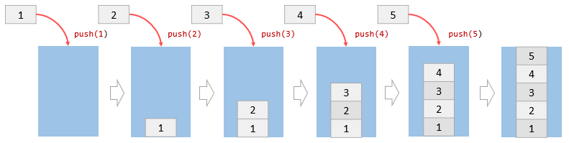
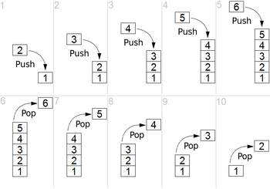
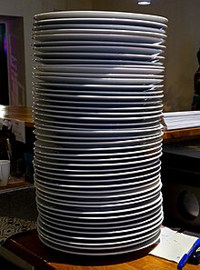
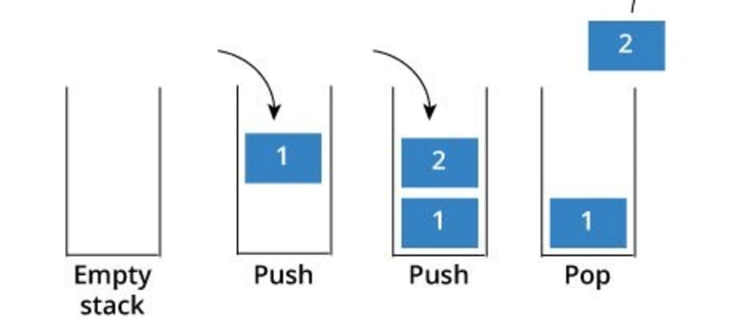
OPERATIONS ON A LIFO (STACK)
Push: Adds an items to the top of the Stack is called Push.
Pop: Removes an element from the top of the Stack is called as Pop.
Size: Determines the number of elements is called as Size.
IsEmpty: Determines whether the Stack is Empty

Slide 9
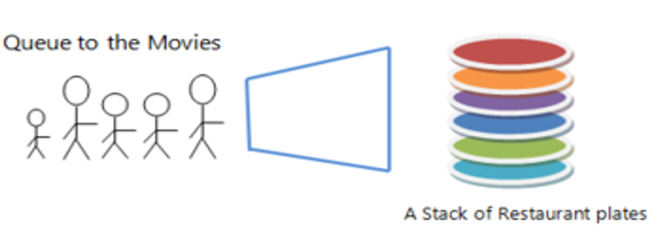
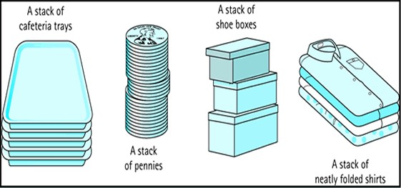
Examples of Queue and Stacks

Slide 10
SIRO (Serve in Random Order)

Slide 11
TYPES OF QUEUE
Circular Queue
Priority Queue (M-Tag)
Input Restricted Queue
Output Restricted Queue

Slide 12
Single Server Queue

Slide 13
Multi-Server Queue

Slide 14
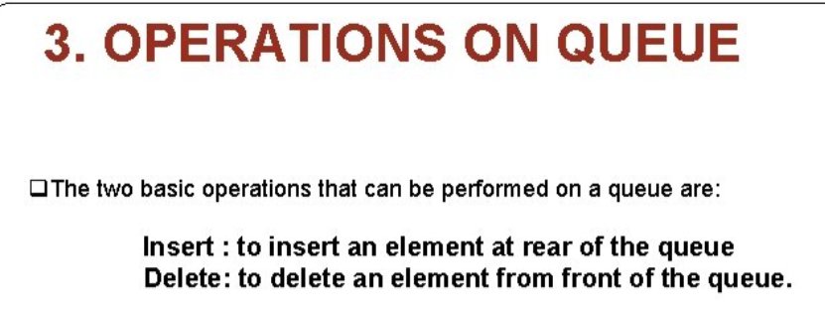

Slide 15
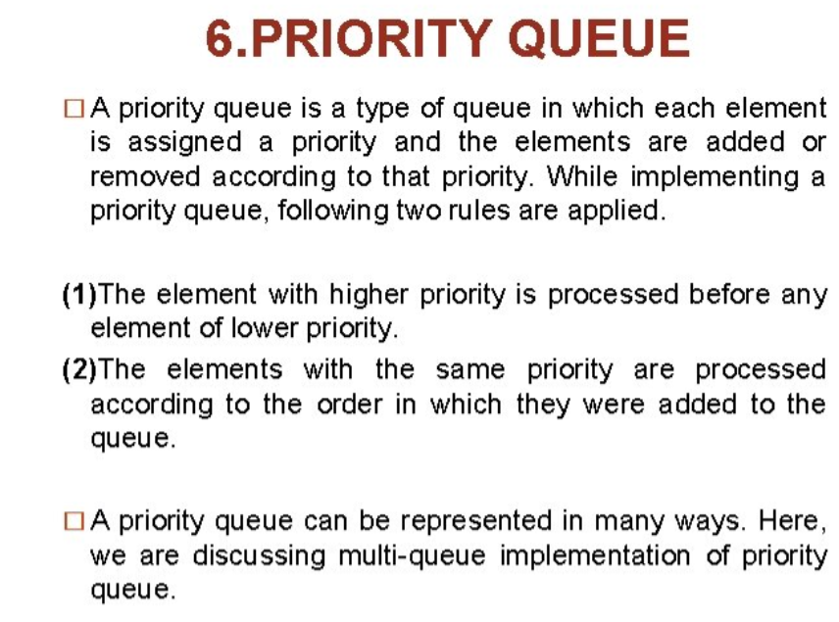

Slide 16
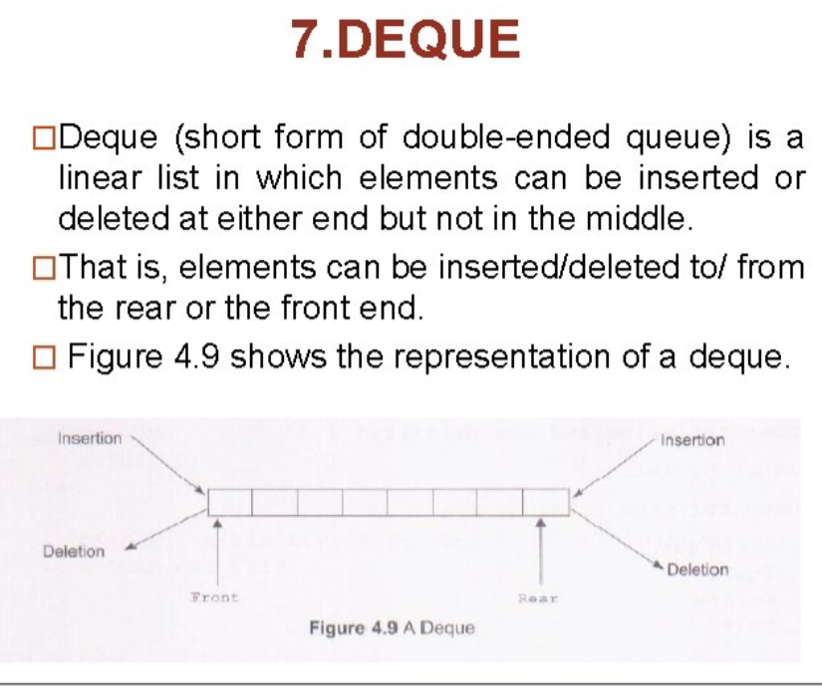

Slide 17
